Slide 1

BRITISH AIRWAYS CUSTOMER AIRLINE REVIEWS
Prepared by: Arthur Chong

Slide 2
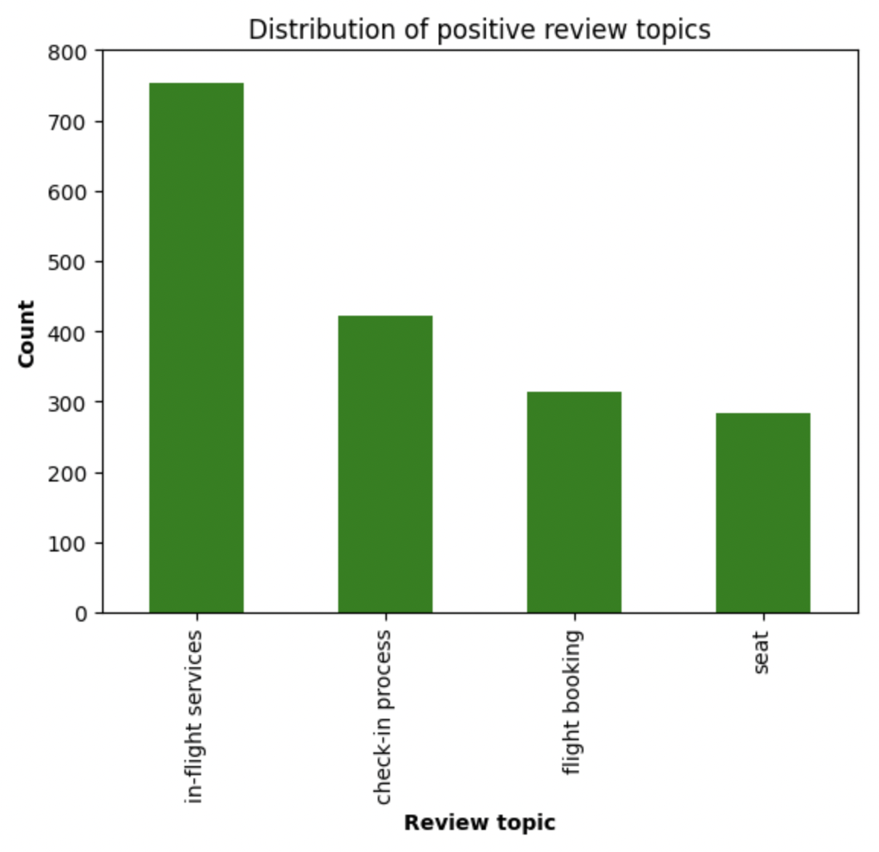
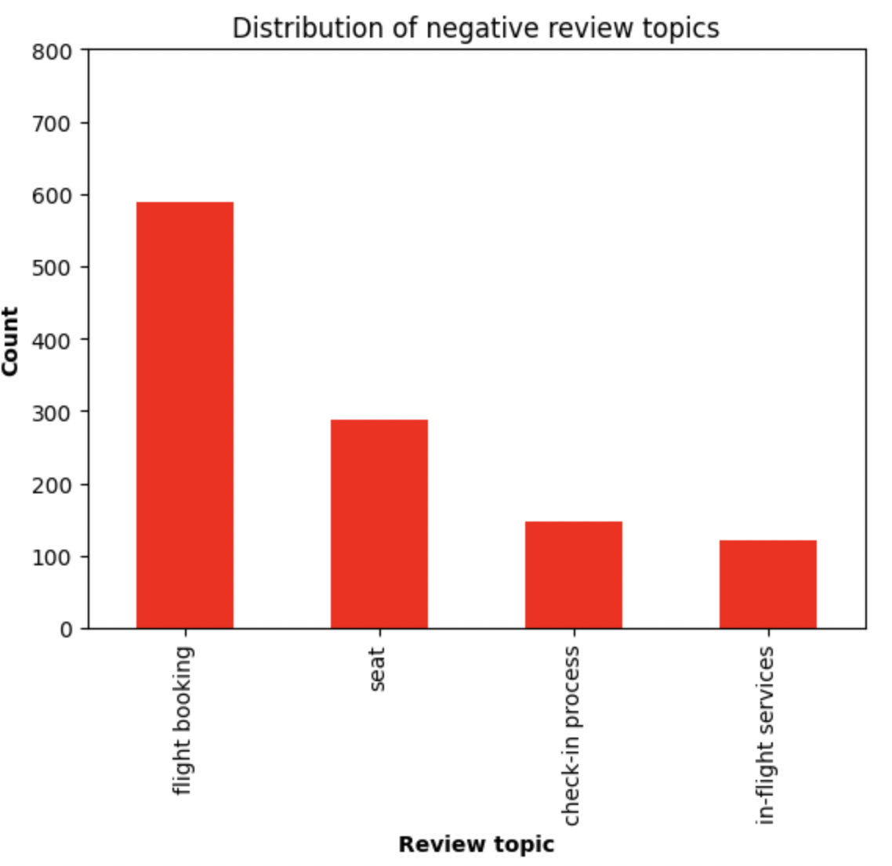
Analysis
Key Topic Reviews by Sentiments
Sentiment
Even though most reviews were positive, there is still a significant number of negative reviews, indicating room for improvement
Positive | 2091
Negative | 1431
Neutral | 95
58%
positive
40%
negative
Most negative reviews were related to flight bookings while most positive reviews were related to in-flight services. Flight booking processes should be revisited to ensure a smooth booking process and reduce flight cancellations.
2%
neutral

